Slide 1
Digital Image Processing
Lecture 2: Digital Image Fundamentals
Dr. Hossam Mahmoud Moftah
Assistant professor – Faculty of computers and information – Beni Suef University

Slide 2
Human Visual System

Slide 3
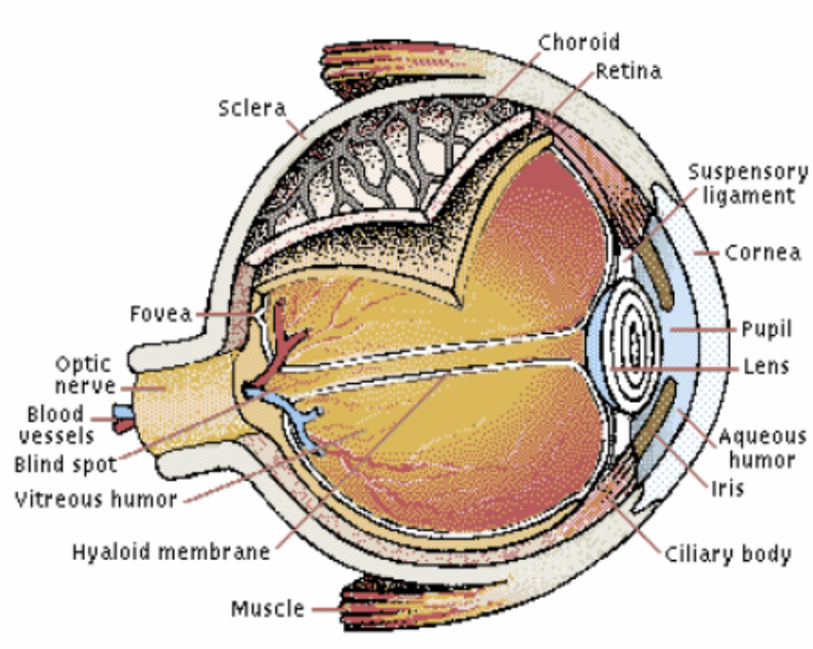
Human Visual System
Elements of visual perception
The amount of light entering the eye is controlled by the pupil,
the light is focused on the retina, where receptors convert it into nerve signals that pass to the brain.

Slide 4
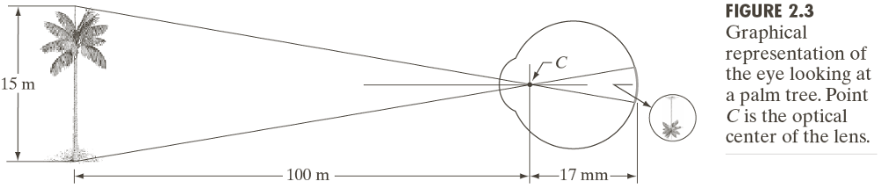
Human Visual System

Slide 5
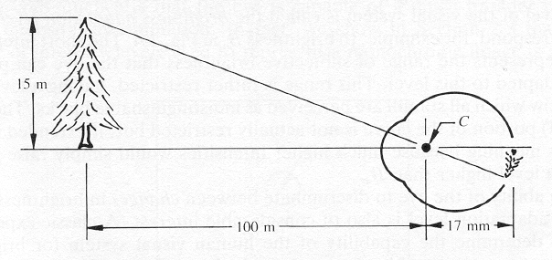
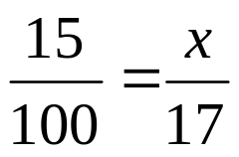
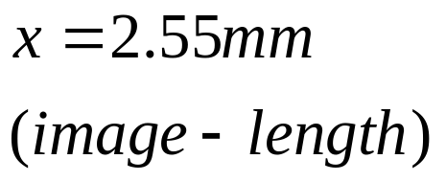
Image Formation in the Eye
Example:
  Calculation of retinal image of an object

Slide 6
Human Visual System
Elements of visual perception
  Cones
    6 – 7 million in each eye
    Photopic or bright-light vision
    Highly sensitive to color
  Rods
    75 – 150 million
    Not involved in color vision
    Sensitive to low level of illumination (scotopic or dim-light vision)
  An object appears brightly colored in daylight will be seen colorless in moonlight (why)

Slide 7
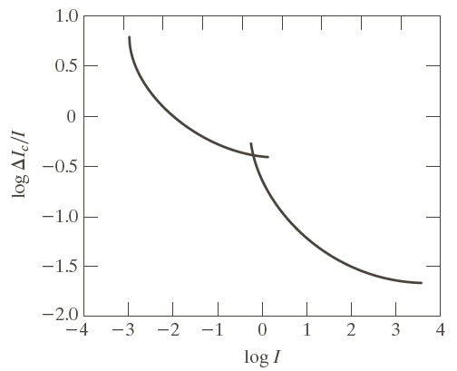
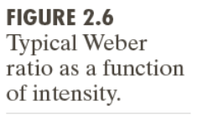
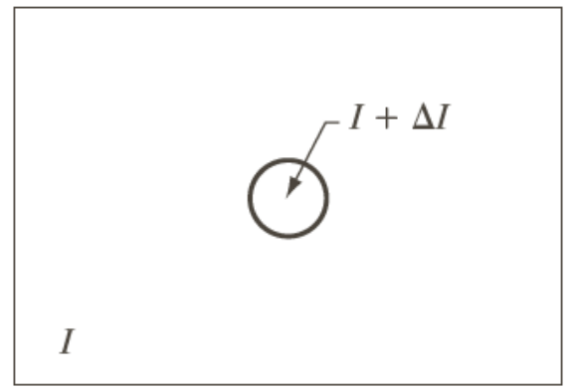
Brightness Adaptation & Discrimination
Brightness discrimination: The ability of the eye to discriminate between changes in light intensity at any specific adaptation level is also of considerable interest.
It is important in the design of images, cameras, image acquisition devices – to discriminate between objects
Low intensity
Dark
Light
High intensity

Slide 8
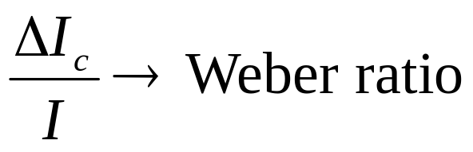
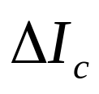
Brightness Adaptation & Discrimination
The eye also discriminates between changes in brightness at any specific adaptation level.
Where : the increment of illumination
I : background illumination

Slide 9
Brightness Adaptation & Discrimination
Small values of Weber ratio mean good brightness discrimination (and vice versa).
At low levels of illumination brightness discrimination is poor (rods) and it improves significantly as background illumination increases (cones).

Slide 10
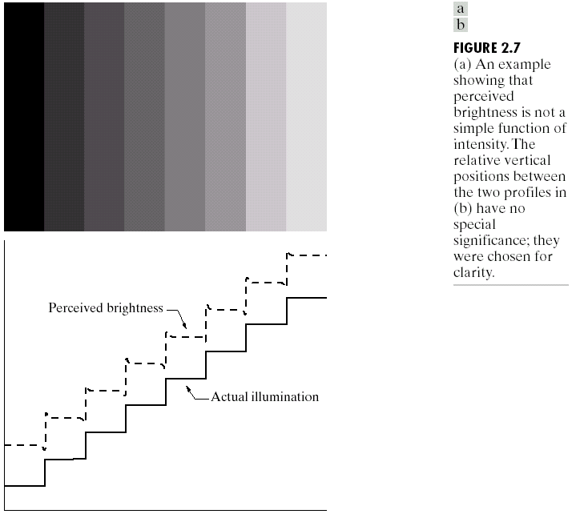
human perception phenomena
Perceived Brightness
Two phenomena clearly demonstrate that perceived brightness is not a simple
function of intensity.
The first is based on the fact that the visual system
tends to undershoot or overshoot around the boundary of regions of different intensities.
Our visual perception
depends on
what are surrounding us

Slide 11
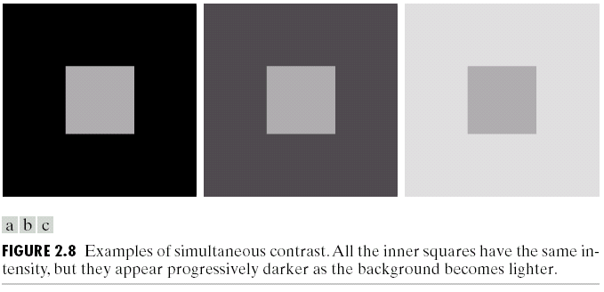
human perception phenomena
The second phenomenon, called simultaneous contrast, is related to the fact that a region’s perceived brightness does not depend simply on its intensity.
Simultaneous Contrast

Slide 12
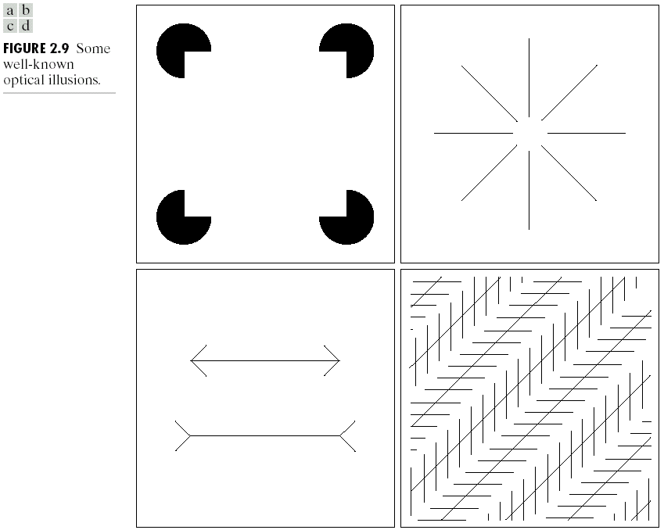
human perception phenomena
Other examples of human perception phenomena are optical illusions, in which the eye fills in nonexisting information or wrongly perceives geometrical
properties of objects.
Illusions

Slide 13
Image Formation

Slide 14


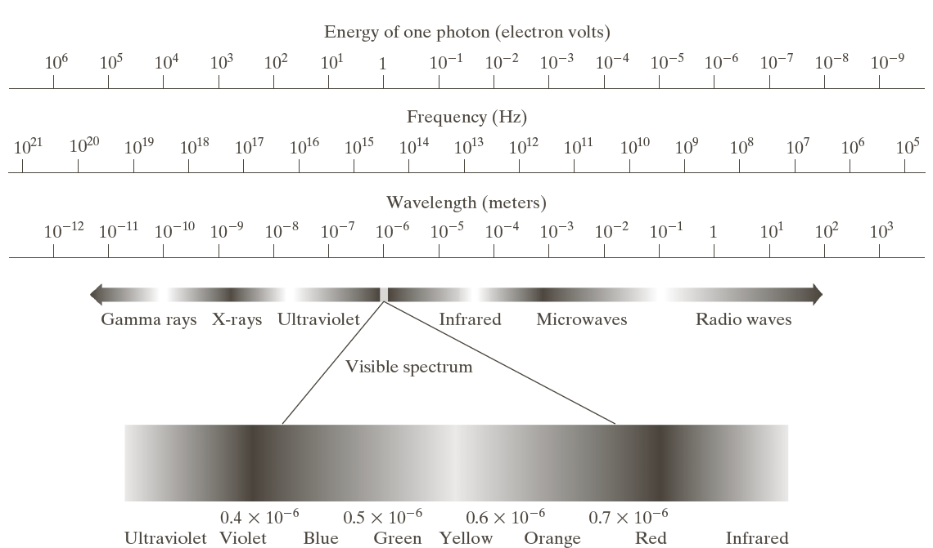

Light and the Electromagnetic Spectrum
The electromagnetic spectrum can be expressed in terms of wavelength, frequency, or energy. Wavelength and frequency are related by the expression:
where c is the speed of light (2.998*10⁸ ms)
The energy is given by the expression:
where h is Planck’s constant.

Slide 15
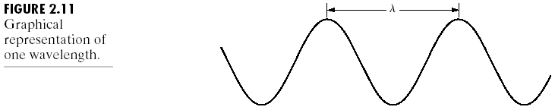
Light and the Electromagnetic Spectrum
Electromagnetic waves can be visualized as propagating sinusoidal waves with wavelength l (Fig. 2.11)

Slide 16
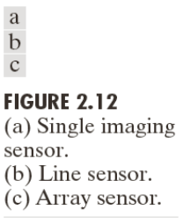
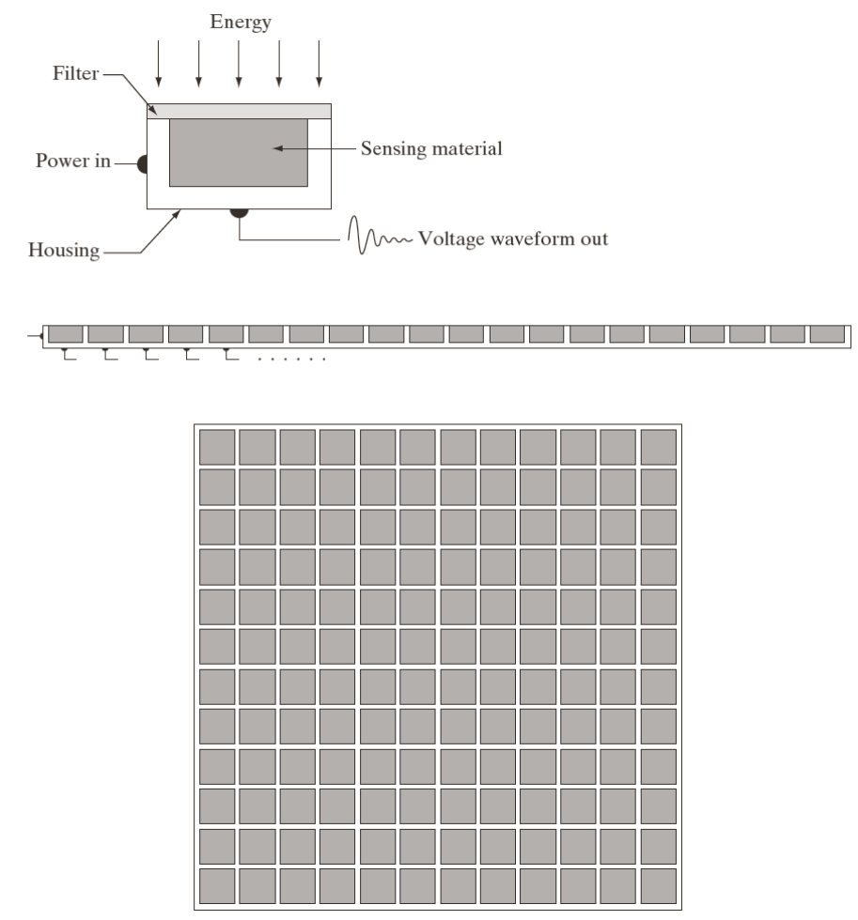
Image Sensing and Acquisition
In HVS – sensors such as rods and cones in retina
Figure 2.12 shows the three principal sensor arrangements used to transform illumination energy into digital images.
Incoming energy is transformed into a voltage by the combination of input electrical power and sensor material.
The output voltage waveform is the response of the sensor(s), and a digital quantity is obtained from each sensor by digitizing its response.

Slide 17

Image Sensing and Acquisition
The value or amplitude of f (x, y) at spatial coordinates
(x, y) is a positive scalar quantity whose physical meaning is determined by the source of the image.

Slide 18
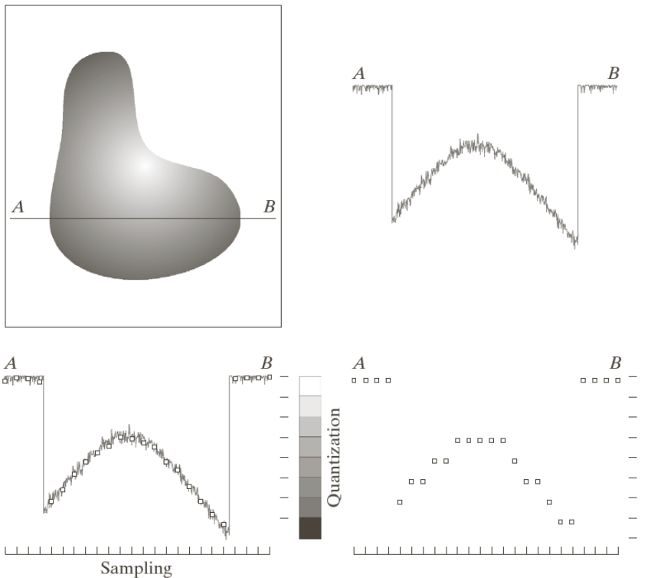
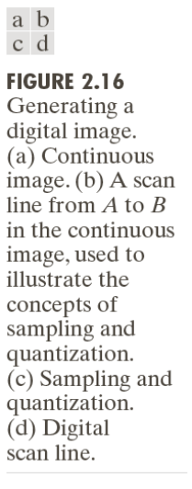
Representing Digital Images
Sampling is the reduction of a continuous signal to a discrete signal.
Digitizing the coordinate values is called sampling.
Digitizing the amplitude values is called quantization.

Slide 19
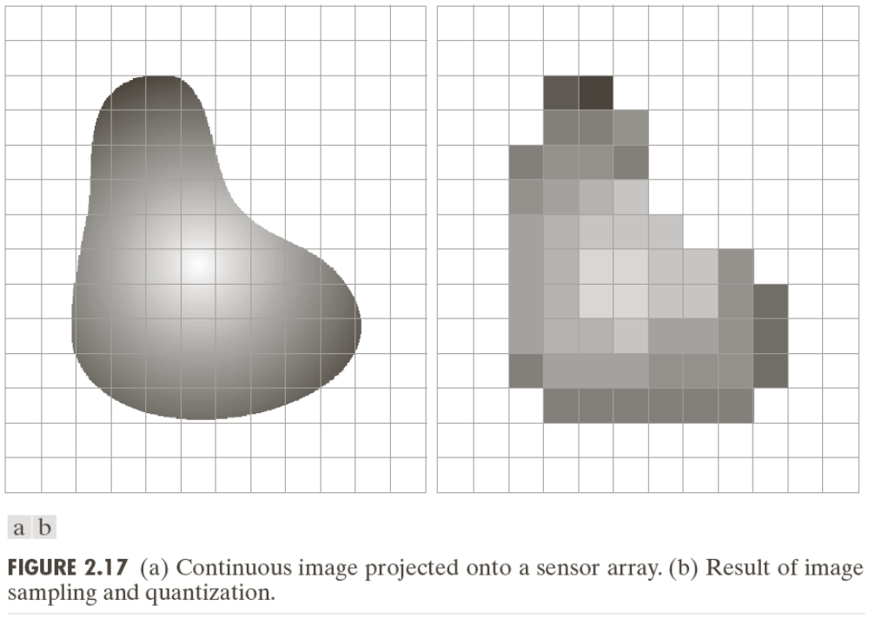
Image Sampling and Quantization
i.e. 256*256 number of pixels- 8 bits
256 gray values
i.e. 512 *512 number of pixels- 8 bits
256 gray values –more memory but better quality
Pixel (Picture element)
Assume that an image f(x, y) is sampled so that the resulting digital image has M rows and N columns.
The values of the coordinates (x, y) now become discrete quantities.

Slide 20
Image Sampling and Quantization
In color images: RGB
Red-Green-Blue
Modern cameras save 3 images
i.e. 1 second video=30*3=90 images
Pixel (Picture element)

Slide 21
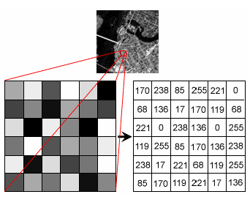
Image Representation
An image defined in the "real world" is considered to be a function of two real variables, for example, f(x,y) with f as the amplitude (e.g. brightness) of the image at the real coordinate position (x,y). The effect of digitization is shown in the next Figure .

Slide 22
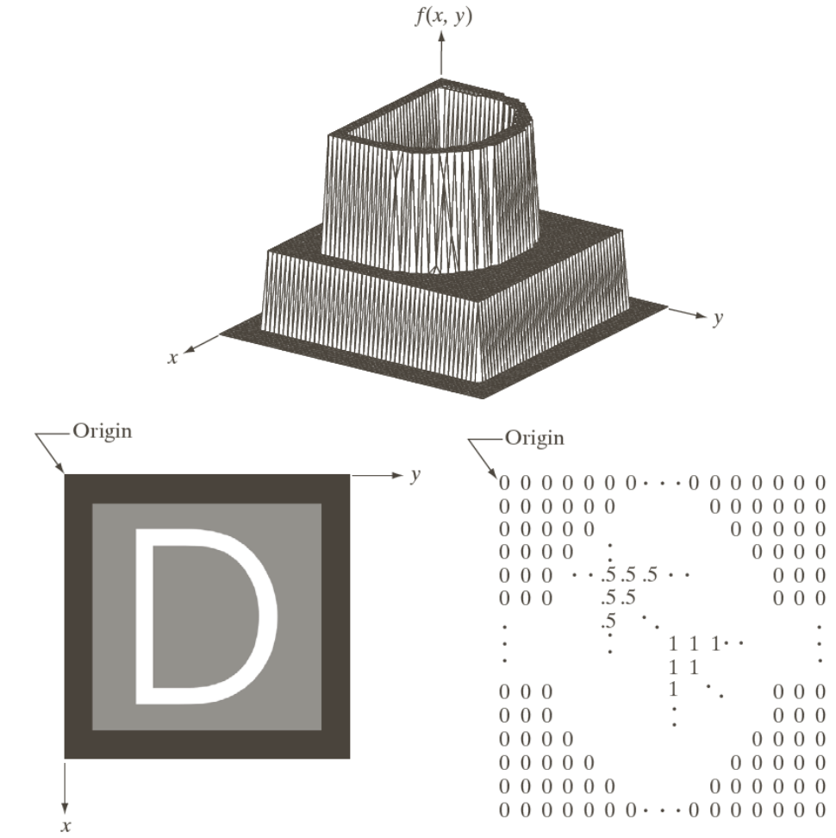
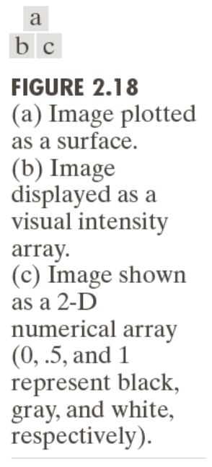
Image Sampling and Quantization

Slide 23
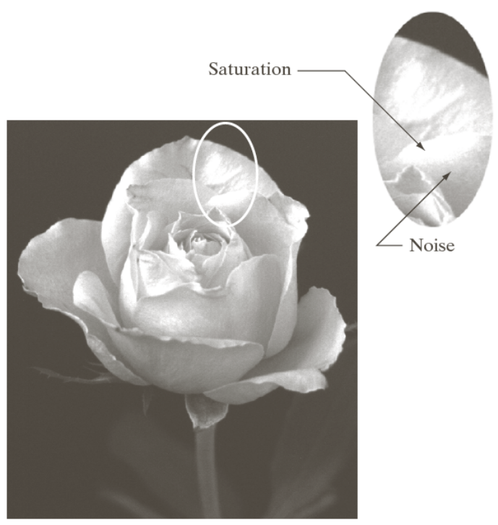
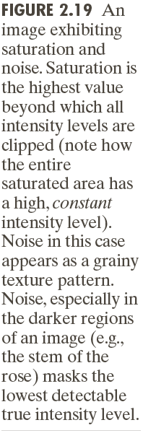
Image Sampling and Quantization

Slide 24
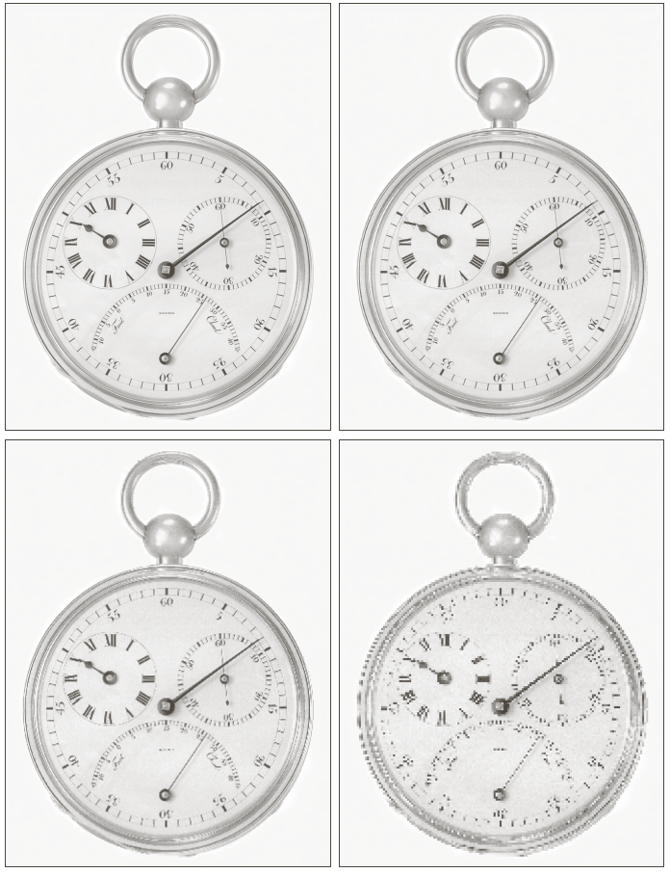
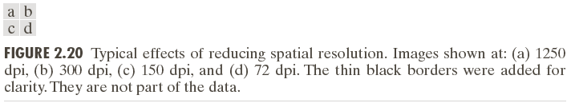
Effects of Reducing Spatial Resolution
Lot of pixels
Less dens

Slide 25
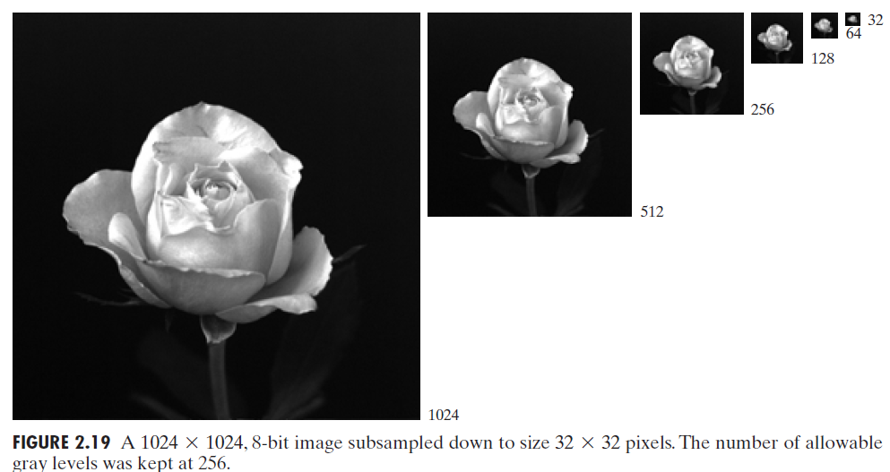
Effects of Reducing Special Resolutions (subsamplig)
Lab Assignment: using python
Subsamples 2D images (whose gray levels are represented by 8 bits) by deleting approprite rows and columns. Returns subsampled image.

Slide 26
Effects of Reducing Special Resolutions
The subsampling was accomplished by deleting the appropriate number of rows and columns from the original image.
For example, the 512*512 image was obtained by deleting every other row and column from the 1024*1024 image.
The 256*256 image was generated by deleting every other row and column in the 512*512 image, and so on.
The number of allowed gray levels was kept at 256.

Slide 27



Effects of Reducing Gray Levels
Lab Assignment: using python
SubSampling:
Selecting one single value to represent several values in
a part of the image.
i.e:
(2,3)-> 2
(4,5)-> 4
Example: if x=9,
= 2
8

Slide 28

Effects of Reducing Gray Levels
Lab Assignment: using Matlab

Slide 29
The end

